Slide 1
Pivot Tables and Hypothesis Tests Day 24
MA 207

Slide 2
Pivot Tables and Hypothesis Tests
When working with data in spreadsheet form, we need to summarize things like
a) How many people fall into category A or category B?
b) Of the people in category A, how many also fall into category C?
c) What is the average height/weight/income/etc. of people in category A vs. category B?
Pivot tables are a built-in Excel tool that can help us do this faster and with less error.

Slide 3
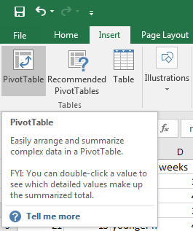
Starting a pivot table
Example 1: Download a fresh copy of the babysmoke data.
While clicking anywhere in the data set, go to Insert -> PivotTable

Slide 4
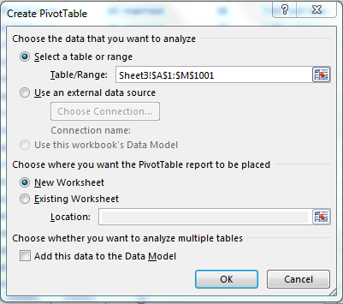
Creating a Pivot Table
Check that the table/range looks appropriate. Change if necessary
Then either select “New Worksheet” or “Existing Worksheet” to pick a location for you table.

Slide 5
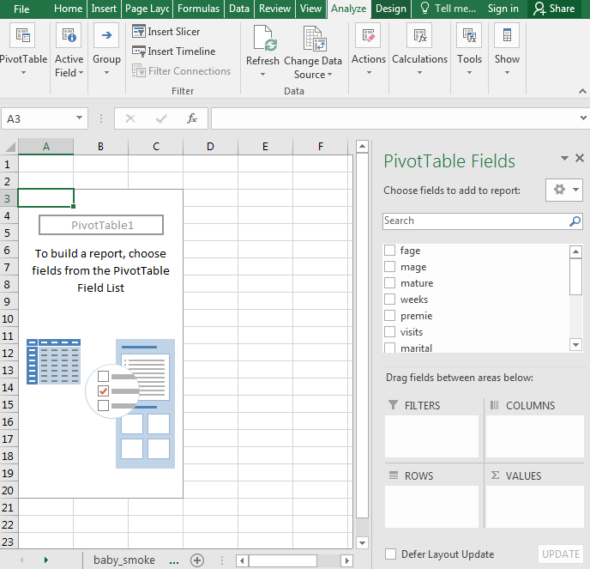

Slide 6
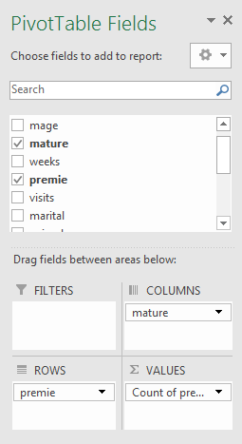
Choose attributes – Think about the context logically
Add mature to the column space
Add premie to the row space
Add premie (or mature) to the values space and make sure it is set as “count” rather than sum or average

Slide 7
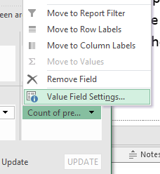
Choose attributes – Think about the context logically
Add mature to the column space
Add premie to the row space
Add premie (or mature) to the values space and make sure it is set as “count” rather than sum or average

Slide 8
Choose attributes – Think about the context logically
Add mature to the column space
Add premie to the row space
Add premie (or mature) to the values space and make sure it is set as “count” rather than sum or average
Alter Row Labels to remove NA, if needed

Slide 9
Your turn
Modify your pivot table to help you check your counts for the “low birth weight” and “smoking” relationship.
Then download the OKCupid data set and build a pivot table using any two attributes you like.

Slide 10
Your turn
Modify your pivot table to help you check your counts for the “low birth weight” and “smoking” relationship.
Then download the OKCupid data set and build a pivot table using any two attributes you like.
Worksheet to practice with Pivot tables. Submit this at the end of class today.

